Slide 1

WIPRO NGA Program – CSI-DC Batch-6
Capstone Project Presentation – 05 May 2024
Project Title Here - Cloud Computing
Presented by - Mercy Joel Vunnamatla
www.rpsconsulting.in

Slide 2
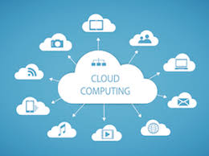

Introduction
What is Cloud Computing?
Cloud computing is the delivery of computing services—including servers, storage, databases, networking, software, analytics, and intelligence—over the Internet
2024 - RPS Consulting all rights reserved

Slide 3
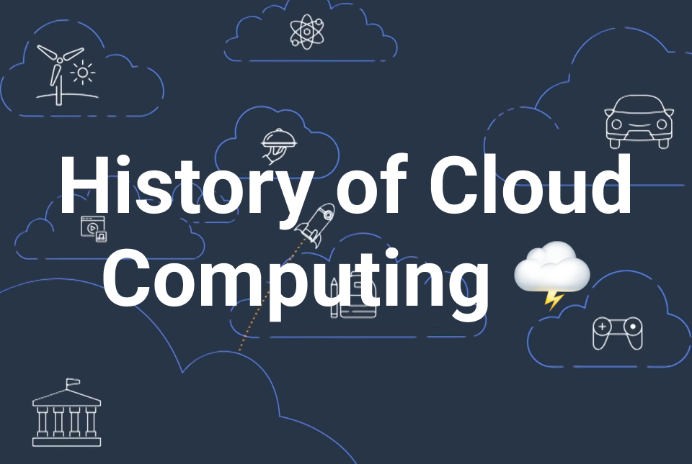
History of Cloud Computing
Early Concepts:
Time-Sharing: A method from the 1960s allowing multiple users to share computing resources.
Mainframes: Centralized, powerful computers used for large-scale tasks.
Evolution:
Virtual Machines (VMs): Enabled multiple operating systems to run on a single physical server.
The Cloud Era: Began with the mid-2000s launch of Amazon Web Services (AWS).
Milestones:
2006: AWS launches services like EC2 and S3.
Late 2000s: Growth of SaaS applications like Salesforce.
2024 - RPS Consulting all rights reserved

Slide 4
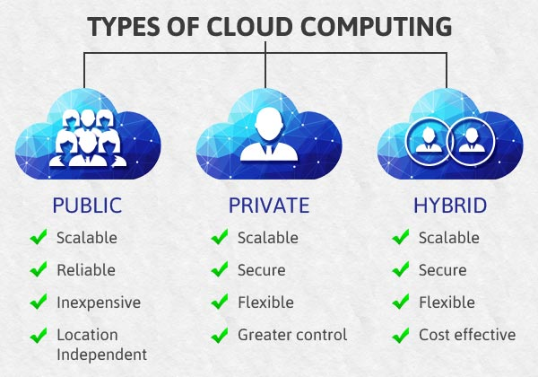
Types of Cloud Computing
Public Cloud:
Services offered over the public internet, accessible to anyone.
Examples: AWS, Microsoft Azure
Private Cloud:
Cloud infrastructure operated solely for a single organization, offering more control and privacy.
Hybrid Cloud:
Combines public and private clouds, allowing data and applications to be shared between them.
2024 - RPS Consulting all rights reserved

Slide 5
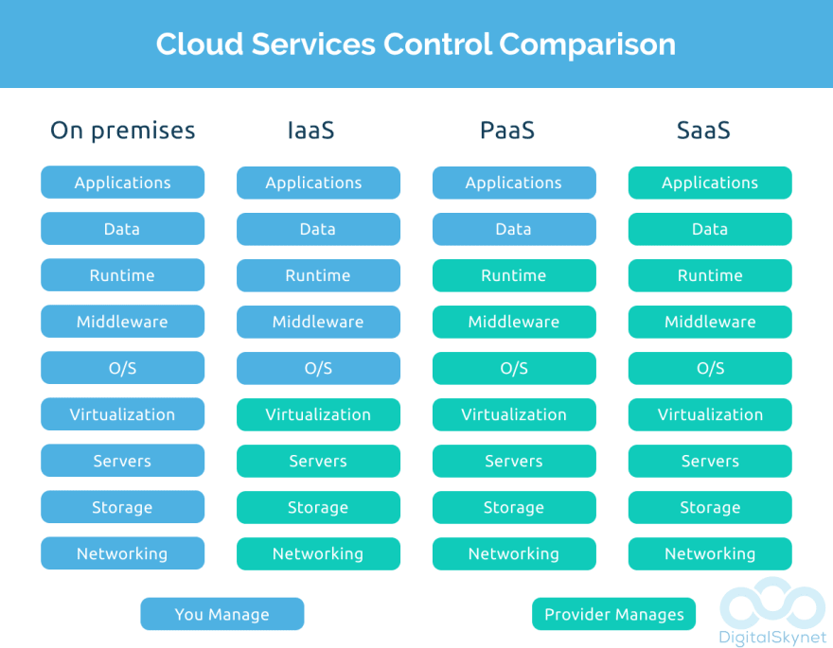
Cloud Service Models
Infrastructure as a Service (IaaS):
Provides virtualized computing resources over the internet.
Examples: AWS EC2, Google Compute Engine
Platform as a Service (PaaS):
A platform that allows customers to develop, run, and manage applications without dealing with infrastructure.
Examples: Google App Engine, Microsoft Azure
Software as a Service (SaaS):
Delivers software applications over the internet, usually on a subscription basis.
Examples: Google Workspace, Salesforce
2024 - RPS Consulting all rights reserved

Slide 6
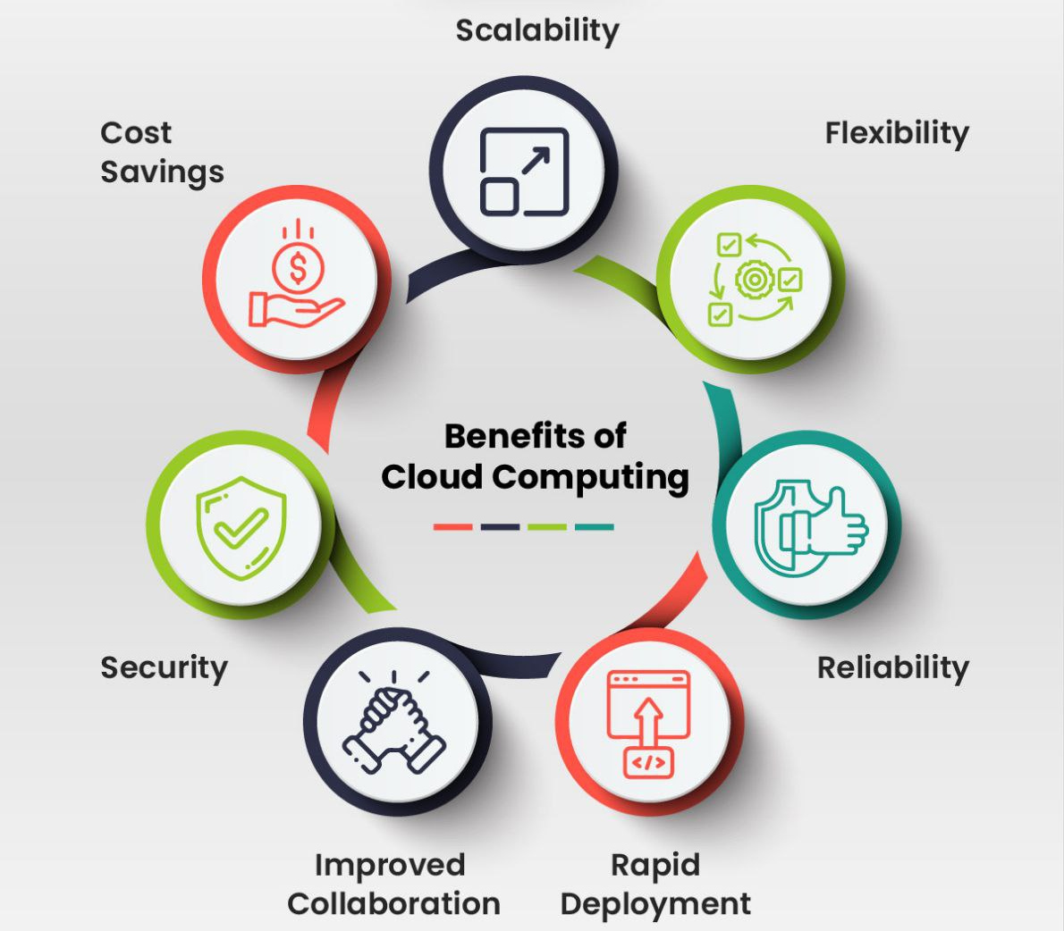
Benefits of Cloud Computing
Scalability:
Easily scale computing resources up or down based on demand.
Cost Efficiency:
Eliminates the need for capital expenses on hardware and software; pay only for what you use.
Accessibility:
Access services and data from anywhere with an internet connection.
Security:
Robust security measures offered by cloud providers.
Disaster Recovery:
Reliable and faster cloud-based backup and recovery solutions compared to traditional methods.
2024 - RPS Consulting all rights reserved

Slide 7
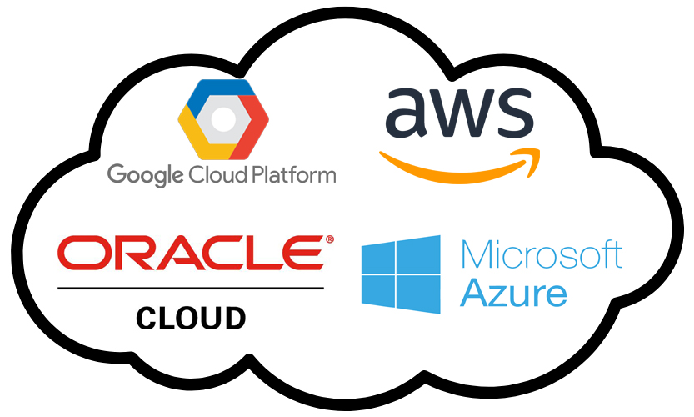
Popular Cloud Providers
Amazon Web Services (AWS):
The most widely adopted cloud platform, offering a vast range of services.
Microsoft Azure:
Integrates with Microsoft products and offers a wide range of PaaS and IaaS services.
Google Cloud Platform (GCP):
Known for powerful data analytics and machine learning services.
Other Providers:
IBM Cloud, Oracle Cloud, Alibaba Cloud.
2024 - RPS Consulting all rights reserved

Slide 8
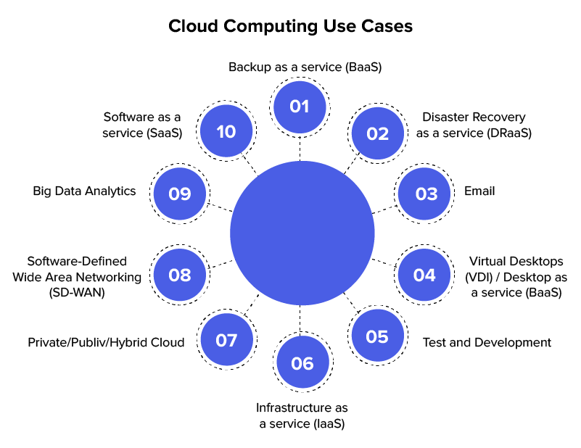
Use Cases of Cloud Computing
Business Applications:
Running enterprise applications like CRM, ERP, and collaboration tools on the cloud.
Data Storage & Backup:
Securely storing large amounts of data, accessible from anywhere.
Big Data & Analytics:
Processing large datasets using cloud-based tools and deriving insights through analytics.
Development & Testing:
Rapid development and testing of applications with scalable resources.
2024 - RPS Consulting all rights reserved

Slide 9

Cloud Security
Importance of Cloud Security:
Protecting data, applications, and services from potential threats and
breaches.
Common Threats:
Data breaches, insecure APIs, account hijacking, insider threats.
Security Best Practices:
Encryption, regular security audits, multi-factor authentication, and compliance with standards like GDPR, HIPAA.
2024 - RPS Consulting all rights reserved

Slide 10
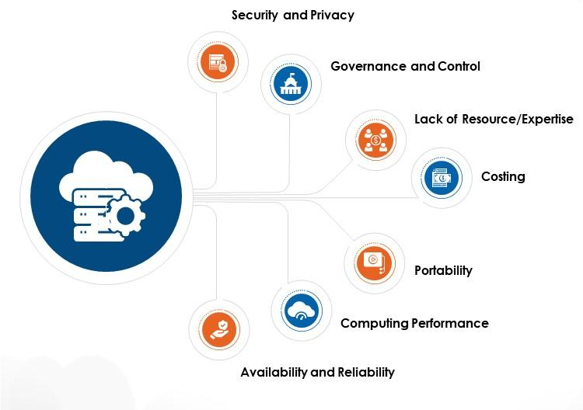
Challenges in Cloud Computing
Data Privacy & Compliance:
Ensuring data storage and processing align with regional laws and regulations.
Downtime & Reliability:
Risk of service outages and ensuring business continuity.
Cost Management:
Controlling cloud costs and avoiding overspending on services.
Vendor Lock-In:
Difficulty in migrating services or data from one cloud provider to another due to proprietary technologies.
2024 - RPS Consulting all rights reserved

Slide 11
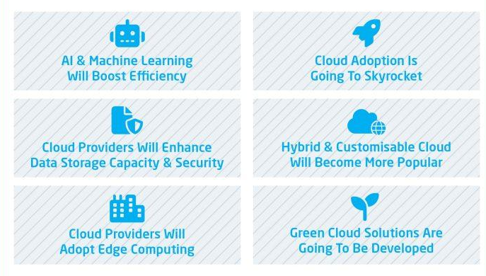
Future of Cloud Computing
Edge Computing:
Processing data closer to where it’s generated to reduce latency and bandwidth use.
AI & Machine Learning Integration:
Leveraging cloud resources for AI/ML model training, deployment, and scaling.
Serverless Computing:
Running functions and microservices without managing underlying infrastructure.
Quantum Computing Potential:
Future integration of quantum computing with cloud services to solve complex problems.
2024 - RPS Consulting all rights reserved

Slide 12

Case Studies
Netflix & AWS:
Netflix uses AWS to stream movies and shows, manage data, and scale resources based on demand.
2024 - RPS Consulting all rights reserved

Slide 13

2024 - RPS Consulting all rights reserved

